Slide 1
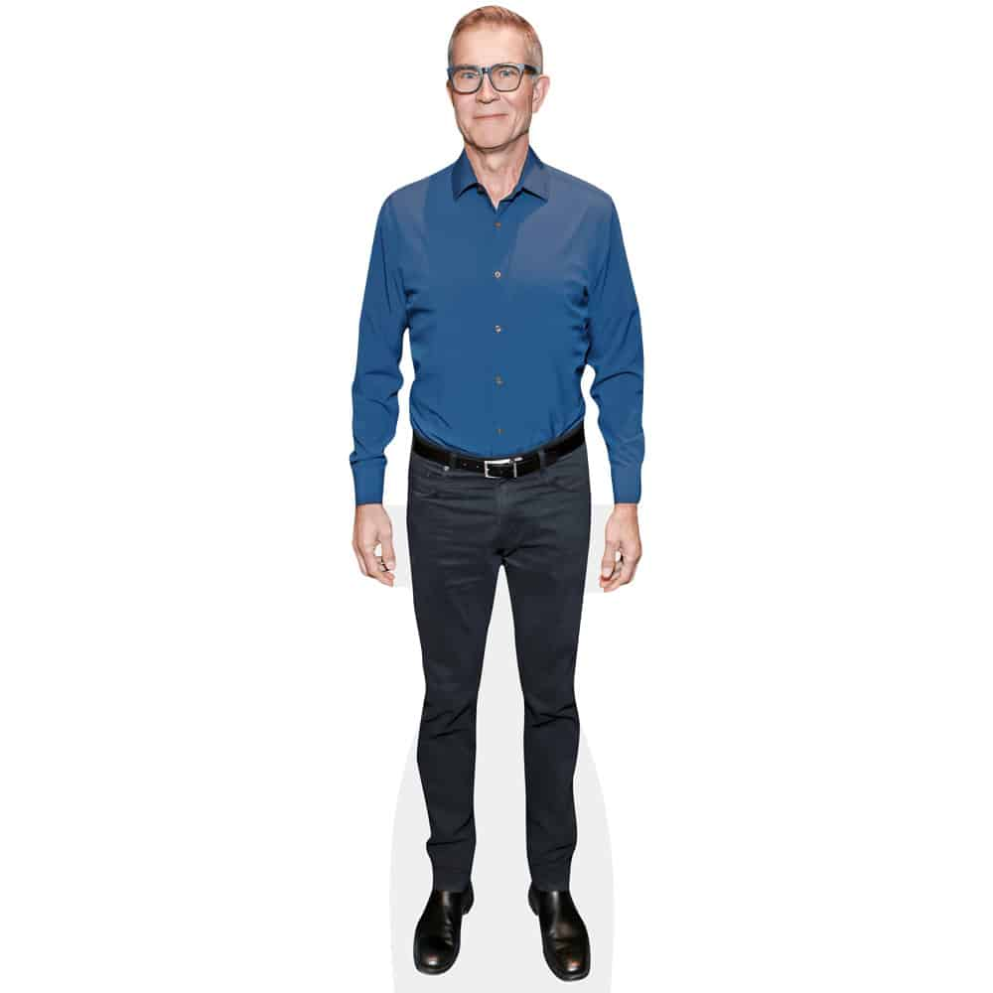
ALL ABOUT DAVID BASZUCKI
Lucas li

Slide 2
Hometown and Age
62 years old
born on 1963

Slide 3
profession
computer programmer
entrepreneur
busneissperson

Slide 4
achievement
co-founder and ceo of roblox
— publicly traded compeny

Slide 5
profession
-entrepreneus

Slide 6


Inspiration
I like to play roblox

